Slide 1
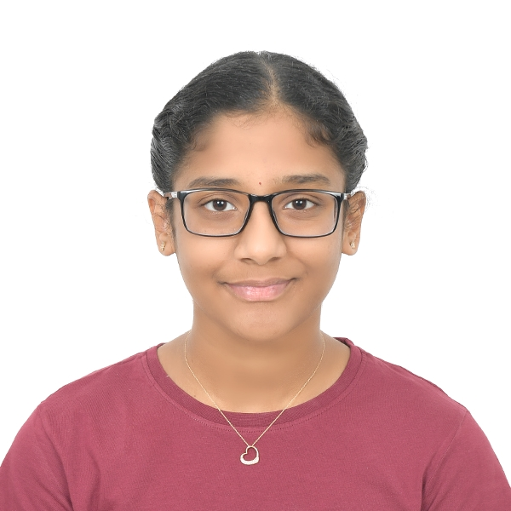

Student Details
NAME:PUJITHA POTLURI
SkiLLSBUILD EMAIL-ID:Pujitha_POTLURI@srmap.edu.in
COLLEGE NAME: SRM UNIVERSITY-AP
COLLEGE STATE:GUNTUR,ANDHRA PRADESH
INTERNSHIP-DOMAIN: DATA ANALYTICS JUNE 3RD-JULY 31ST

Slide 2
PROJECT TITLE/Problem Statement
Insights into the Pre-Owned Vehicle Market: Trends and Depreciation Analysis using CarDekho DataSet

Slide 3
AGENDA
Project Overview
Who are the end users of this Project?
Your Solution and its value proposition
How did you customize the project and make it your own
Modelling
Results
Links

Slide 4
PROJECT OVERVIEW
The second-hand vehicle market is expanding due to the demand for affordable transportation. This project uses data analytics to provide insights into trends, pricing, and depreciation. Key objectives include analyzing vehicle manufacturing years, price ranges, popular models, fuel type impact, and cost depreciation factors. Using Python's pandas library for data cleaning and analysis, the project aims to help dealerships optimize inventory, individuals make informed decisions, and businesses develop targeted marketing strategies. Understanding these market trends can enhance customer satisfaction and improve business performance in the pre-owned vehicle sector.

Slide 5
WHO ARE THE END USERS of this project?
Some of the end users of this project are:
Cars 24
Cars Dekho
Maruti Suzuki TrueValue
This Project is helpful in optimizing inventory and pricing strategies of the above companies.

Slide 6
YOUR SOLUTION AND ITS VALUE PROPOSITION
On analyzing the dataset,we have identified the following trends:
Analyze the distribution and trends of vehicle manufacturing years.
Determine the lowest and highest selling prices of vehicles.
Evaluate the overall volume and completeness of the dataset.
Identify the diversity and popularity of different vehicle models.
Assess the presence and impact of various fuel types, such as CNG.
Examine the sale sources, particularly focusing on individual sellers versus dealers.
Investigate the prevalence of automatic transmission vehicles.
Quantify single-owner vehicles and their market characteristics.
Analyze vehicle cost depreciation and identify factors influencing it.
Explore correlations between vehicle age, distance driven, and selling prices.
Highlight insights on newer vehicles (post-2014) and exceptional deals in both the two-wheeler and four-wheeler segments

Slide 7
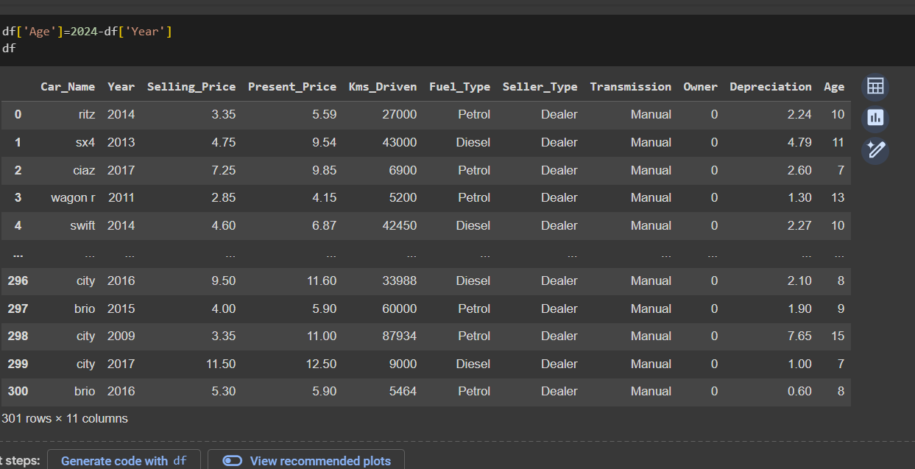
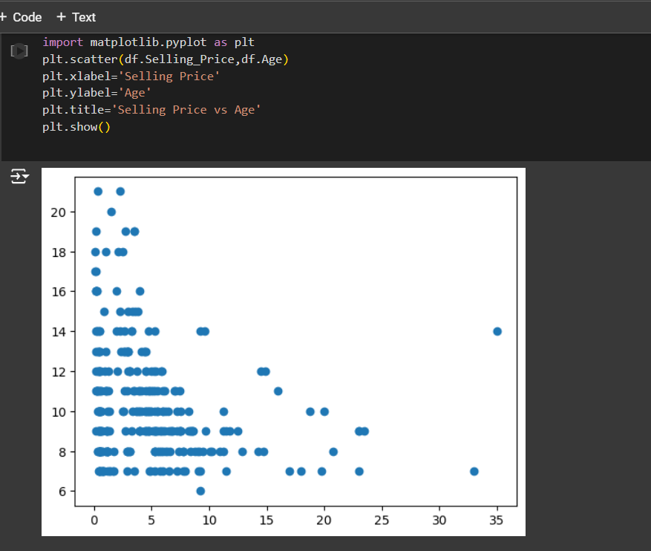
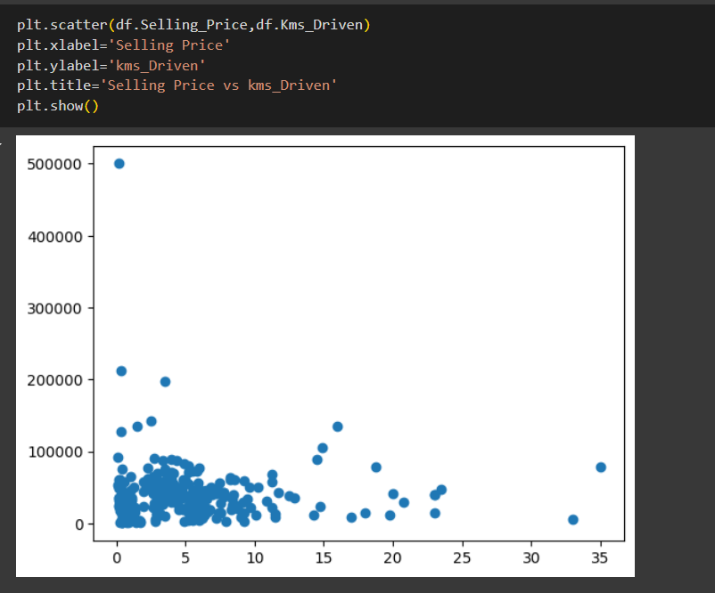
How did you customize the project and make it your own
Tried to do on my own:
In general selling price is affected by age of vehicle
and distance driven by vehicle , is it observable from data ?

Slide 8
MODELLING
To Understand the data following process is used:
Firstly,import pandas as pd to further use it in the project along with functions and upload it in Google Colab.
Read the data from the csv file using read_csv()
To get top 5 and bottom 5 data by default use head() and tail() respectively
describe() to get the statistical analysis,
unique() to get unique values from the dataset based on a particular column and nunique() to get number of unique values. and nunique() to get the number of unique values.
Example:nunique() is used to get different number of vehicles and unique is used for knowing what are the different vehicles in datasets.
value_counts() is used to count the repeated values in a column.
Example:To get different Seller_Types
max() and min() is used to find the maximum and minimum value of a column.
Example:To get maximum and minimum selling_price
Cleaning of data:
The isnull() function is used to check if there are any null values in the given dataset.
To Visualize the data:
Matplotlib in pandas is used to draw bar graphs ,pie charts,scatter plot relationship between two different values,boxplot to find outliers
Example: Scatter plot is used to find relationship between Selling_Price and Age of vehicle also Selling_Price and Kms_Driven
Example:To represent a boxplot for four-wheelers

Slide 9
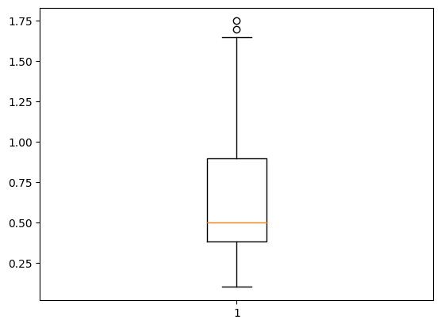
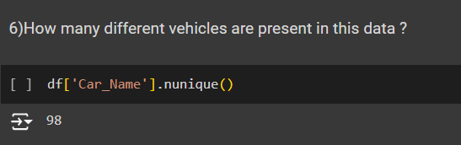
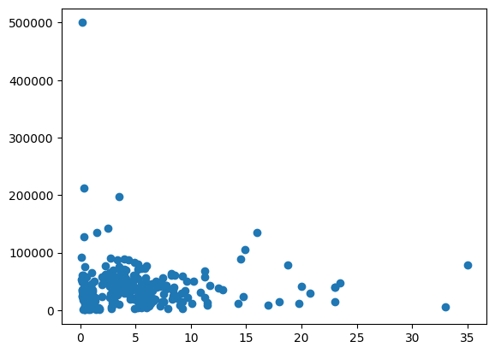
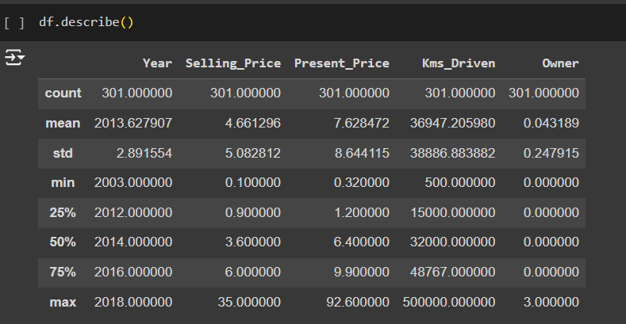
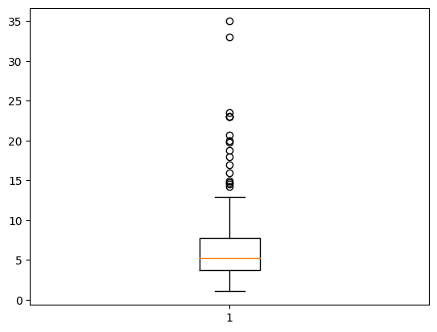
Results
Different type of vehicles present in dataset
Boxplot for the Selling Price of two wheelers
Relation between Selling Price and Kmsdriven
Boxplot for the Selling Price of four wheelers
Statistical information about the dataset

Slide 10
links
CarDekho Dataset from Kaggle:https://www.kaggle.com/datasets/sukritchatterjee/used-cars-dataset-cardekho
Some valuable information: Chatgpt
Project-Github link:https://github.com/PUJITHAPOTLURI/CarDekho-dataset-DA-Project

